Slide 1
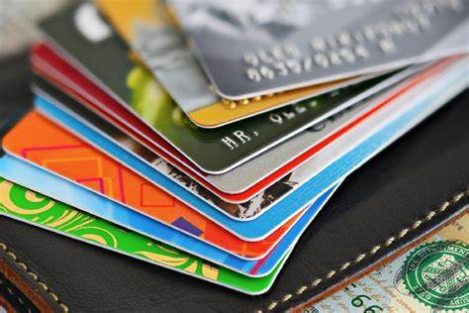
CREDIT CARD TRANSACTION ANALYSIS REPORT
NAME :Shabira .M
DATE :12/7/2023

Slide 2
Summary
“This report presents a comprehensive analysis of credit card transactions over the span of 30 years(1991-2020). The analysis revealed a notable increase in transaction volume and total transaction amounts, especially in the final quarter. We also identified variations in transaction amounts based on payment methods, with credit card transactions dominating. Fraud detection was highly successful, but geographic analysis exposed regional disparities. Our findings provide an opportunity for marketing strategies targeting high-transaction regions. Additionally, recommendations for refining fraud prevention and enhancing customer engagement have been highlighted.”

Slide 3
Introduction
he purpose of conducting an analysis of transactions from the years 1991-2020 is to gain valuable insights and make informed decisions based on historical transaction data. The specific purposes of this analysis can vary depending on the context and the goals of the organization or individual conducting it. Here are some common purposes for such an analysis:
Historical Trend Analysis.
Customer Behaviour Analysis
Marketing and Sales Strategies
Fraud Detection and Prevention
Geographic Analysis
Customer Satisfaction and Engagement

Slide 4
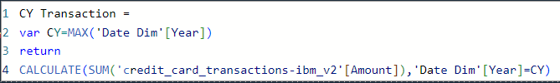
Methodology
Checked the columns with missing value. There is no such columns are detected.
Converted the data type of Amount column to numeric.
Currency units of amount columns are converted.
Validated that date and time column are in correct format.
Trimmed the white spaces from the text columns.
Created a new Date table named ‘Date Dim’ to get a sequential list of dates, which is useful for defining time interval. Then created new calculated columns of year, month and quarter by using formula.
Created new measure named ‘Transaction amount’ to calculate the sum of all transaction amount.
Created another measures named CY Transaction(Current Year Transaction) and PY Transaction(Previous Year Transaction) to get total transaction amount of that selected year.

Slide 5
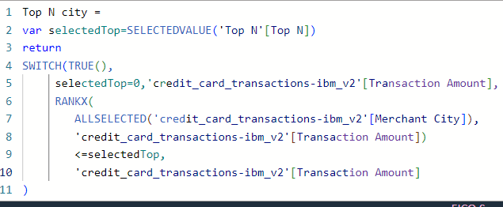
Inserted a new slicer to select Year .
Inserted cards to show CY transaction and PY Transaction for the selected Year.
Created a Clustered bar chart to check top Merchant Cities of selected year .
Wanted to display Top N cities based on particular year, so created a ‘Top N’ measure by using DAX formula.

Slide 6
Transaction Trends
Geographic Analysis
Map visualization created to show the transaction distribution by location. Largest Cities like Houston, Miami,Atlanta,Los Angeles San Francisco, Chicago and Las Vegas in Unites States have the highest transaction rates.
Payment Methods
Stacked bar chart created to visualize the most trending transaction mode. Swipe transaction was the most used transaction method until 2014. Then Online transaction and Chip Transaction are came on most trending. Most people prefer debit card transaction but credit card transaction also there in the second place. Master card and Visa card are widely used.

Slide 7

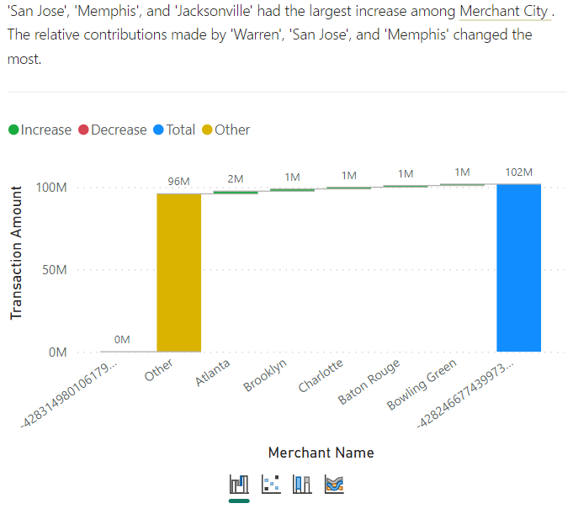
Merchant Name and Transaction rate

Slide 8
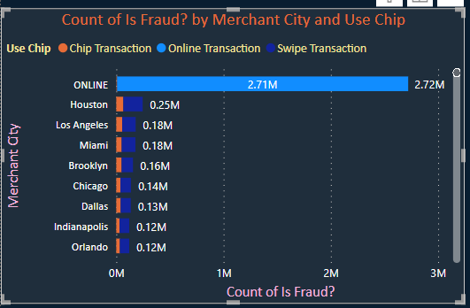
Fraud Detection and Prevention
After analyzed transaction data from 1991-2020 ,encompassing 2.71million fraud detection . Fraud activities are mostly taking place through the online transaction. Largest Cities like Houston, Miami,Atlanta,Los Angeles San Francisco, Chicago and Las Vegas in Unites States have the highest transaction rates as well as the highest fraud rates. Fraud transaction are mostly taking place at the time period of 7.am to 7pm.

Slide 9
Prevention
Fraud prevention measures, including transaction limits and customer verification, have been effective.
Geographic Analysis
The analysis identified geographic regions with the highest fraud rates.
Recommendations
Enhance detection methods for emerging payment fraud patterns.
Implement geographic-specific prevention strategies for high-risk regions
Increase customer awareness through training and communication.

Slide 10
Customer Behavior Analysis
Income distribution are almost similar for Male and Female.
Analysis demonstrate that high-income individual carry mortgage debt.
Low-income category tend to have credit card debt.
Recommendation:
Encourage high-income individuals to invest in assets rathe than carrying excess long term debt.

Slide 11
FICO Score and debt relation
A higher FICO score often results in more favorable lending terms.
Maintaining a good FICO score can provide access to more favorable credit terms.
It’s essential to manage both your FICO score and debt levels responsibly for a healthy financial profile

